Slide 1
Forbairt na Ceannasaiochta sa Bhunscoil Lán Ghaeilge,
2013
Óstán Louis Fitzgerald, Baile Átha Cliath

Slide 2

Kathryn de Brún
Co-ordaitheoir ‘Bunscoil Naomh Proinsias’
151 dalta ar an rolla (843 san iomlán)
7 muinteoir lán-aimseartha, 1 múinteoir páirt-aimseartha
DSS: 40%
Coláisre Chaitríona, Ard Mhacha

Slide 3
Seisiún 2:
Pleanáil agus cur chuige scoile.
Léitheoireacht an Bhéarla sa scoil lán Ghaeilge.

Slide 4
AIDHMEANNA:
- Achoimre a thabhairt ar thorthaí taigde;
- Seicheamh agus modhanna le haghaidh theagasc léitheoireacht an Bhéarla a phlé;
- taithí a roinnt maidir le tabhairt isteach an Bhéarla;
- cúrsaí pleanála agus modhanna measúnaithe do léitheoireacht an Bhéarla a phlé.

Slide 5
Torthaí Taighde
‘Core features of Immersion Programs’
The L2 is a medium of instruction
The immersion curriculum parallels the local L1 curriculum
Overt support exists for the L1
The program aims for additive bilingualism
Exposure to the L2 is largely confined to the classroom
Students enter with similar (and limited) levels of L2 proficiency
The teachers are bilingual
The classroom culture is that of the local L1 community
Cummins, J. (1998)
Notes:
- In classes with a wide range of abilities, the students were grouped by language ability for literacy activities within their classroom. These groups were flexible and temporary, changing according to learners’ growing proficiencies.

Slide 6
Torthaí Taighde (ar lean)
‘Aims of immersion education’
‘…to strengthen and to use both languages to a high level in order to develop balanced and confident bilingual pupils.’
C. Williams. (2002)

Slide 7
Torthaí Taighde (ar lean)
‘The Linguistic Interdependence Principle’
‘To the extent that instruction in Lx is effective in promoting efficiency in Lx, transfer of this proficiency to Ly will occur provided there is adequate exposure to Ly (either in school or environment) and adequate motivation to learn Ly.’
Cummins, J.(1981)
Notes:
- Classes were organised around highly structured, teacher directed activities. Both whole group and small group activities were nearly always teacher directed.
Jill Kerper Mora-
Characteristics of effective bilingual classrooms.2000

Slide 8
Cad é mar a dhéantar ‘tabhairt isteach an Bhéarla’?

Slide 9
Fás agus forbairt na léitheoireachta
Ag dul i dtaithí / Experiential
Fadhbfhuascailt/ problem solving
Eiseamláiriú/ modelled
I gComhpháirt / shared
Faoi threoir / guided
Neamhspleách/ independent
(M.Kerr, COLIT Idirbhoird)

Slide 10
 | Téarma 2
Rang 3- English | ÉANAIR/FEABHRA Modelled reading, teacher reading a range of high interest texts out loud to class. Use of questioning to extend understanding. Phonological awareness (syllables/rhyme/initial sounds) Completion of PM Benchmarking Kit running records to ascertain English reading baseline position MÁRTA AR AGHAIDH… (páistí ar scoil go 3 i.n.) Easy read shared ‘big book texts’ with focus on grapheme/phoneme correspondence, modelled strategies for decoding, language of books in English etc… Grouping of pupils for English Literacy lessons according to PM Benchmarking kit Roll-out of the Linguistic Phonics English program Literacy/Guided reading lessons twice weekly in English Observation of pupil progress through guided reading sessions, completion of further running records for movement within colour bands of PM reading program Visit to school library every 2nd week for English ‘own choice’ text for independent reading

Slide 11
Léamh os ard- cad chuige?
ag tacú le forbairt na teanga labhartha agus ag forbairt feasa ar chomhréir agus ar struchtúr téacs.

Slide 12
“ By modelling for students the types of behaviours good readers are engaged in as they read, we are providing them with the opportunity to become aware of the many strategies and monitoring behaviours that good readers use. When competent readers are reading suitable texts, these strategic behaviours are fairly automatic but for struggling readers this does not prove automatic. Therefore modelling strategic behaviours for struggling readers by thinking aloud for them while we read ( and hence, allowing students to think along), is the first step in raising their awareness of what it means to be a strategic reader.”

Slide 13
Léamh i gcomhpháirt- cad chuige?
- dearbheiseamláiriú ar straitéisí léitheoireachta i gcomhthéacs tacaíochta atá sultmhar.

Slide 14
“ Shared Reading is an interactive reading experience that occurs when students join in or share the reading of a big book or other enlarged text while guided and supported by a teacher or another experienced reader. Children observe an expert reading the text with fluency and expression. The text must be large enough for all the students to see clearly, so they can share in the reading of the text. It is through Shared Reading that the reading process and reading strategies that readers use are demonstrated. In shared reading, children participate in reading, learn critical concepts of how print works, get the feel of learning and begin to perceive themselves as readers.” ( Fountas & Pinnell, 1996)

Slide 15
Léitheoireacht faoi threoir- cad chuige?
- ag cur éispiris agus dúshláin chuí roimh an léitheoir.

Slide 16
Le léitheoireacht faoi threoir…..
Bíonn i gcónaí cuspóir soiléir ann
Oibríonn na páistí I ngrúpaí de sheisear ar feadh 10 mbomaite, uair sa tseachtain ar a laghad.
Treoraíonn an múinteoir an léitheoireacht cé gur féidir le ról an mhúinteora athrú.
Cuirtear na páistí i ngrúpaí de réir ábaltachta.
Is cuid an-tábhachtach é an plé a dhéantar ar an téacs.
Léann na páistí go léir an téacs neamhaithnidíuil céanna, roghnaithe ag an mhúinteoir.
Léann na páistí ag a gcuid luasanna féin agus na múinteoirí ag díriú airde ar pháistí áirithe le linn léitheoireachta.
Déantar cuid is mó den léitheoireacht go tostach – déantar léitheoireacht os ard ar mhaithe le crúthú.
(leasaithe ó First Steps, leagan NLS)

Slide 17
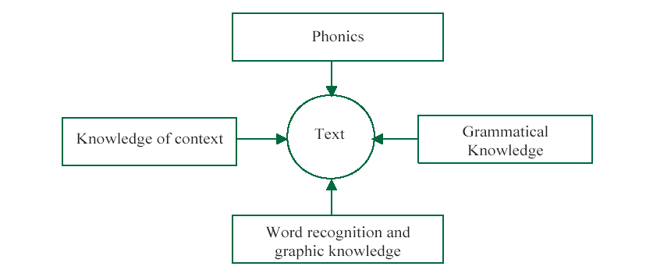
www.publications.parliament.uk
‘Searchlights’ model of reading

Slide 18
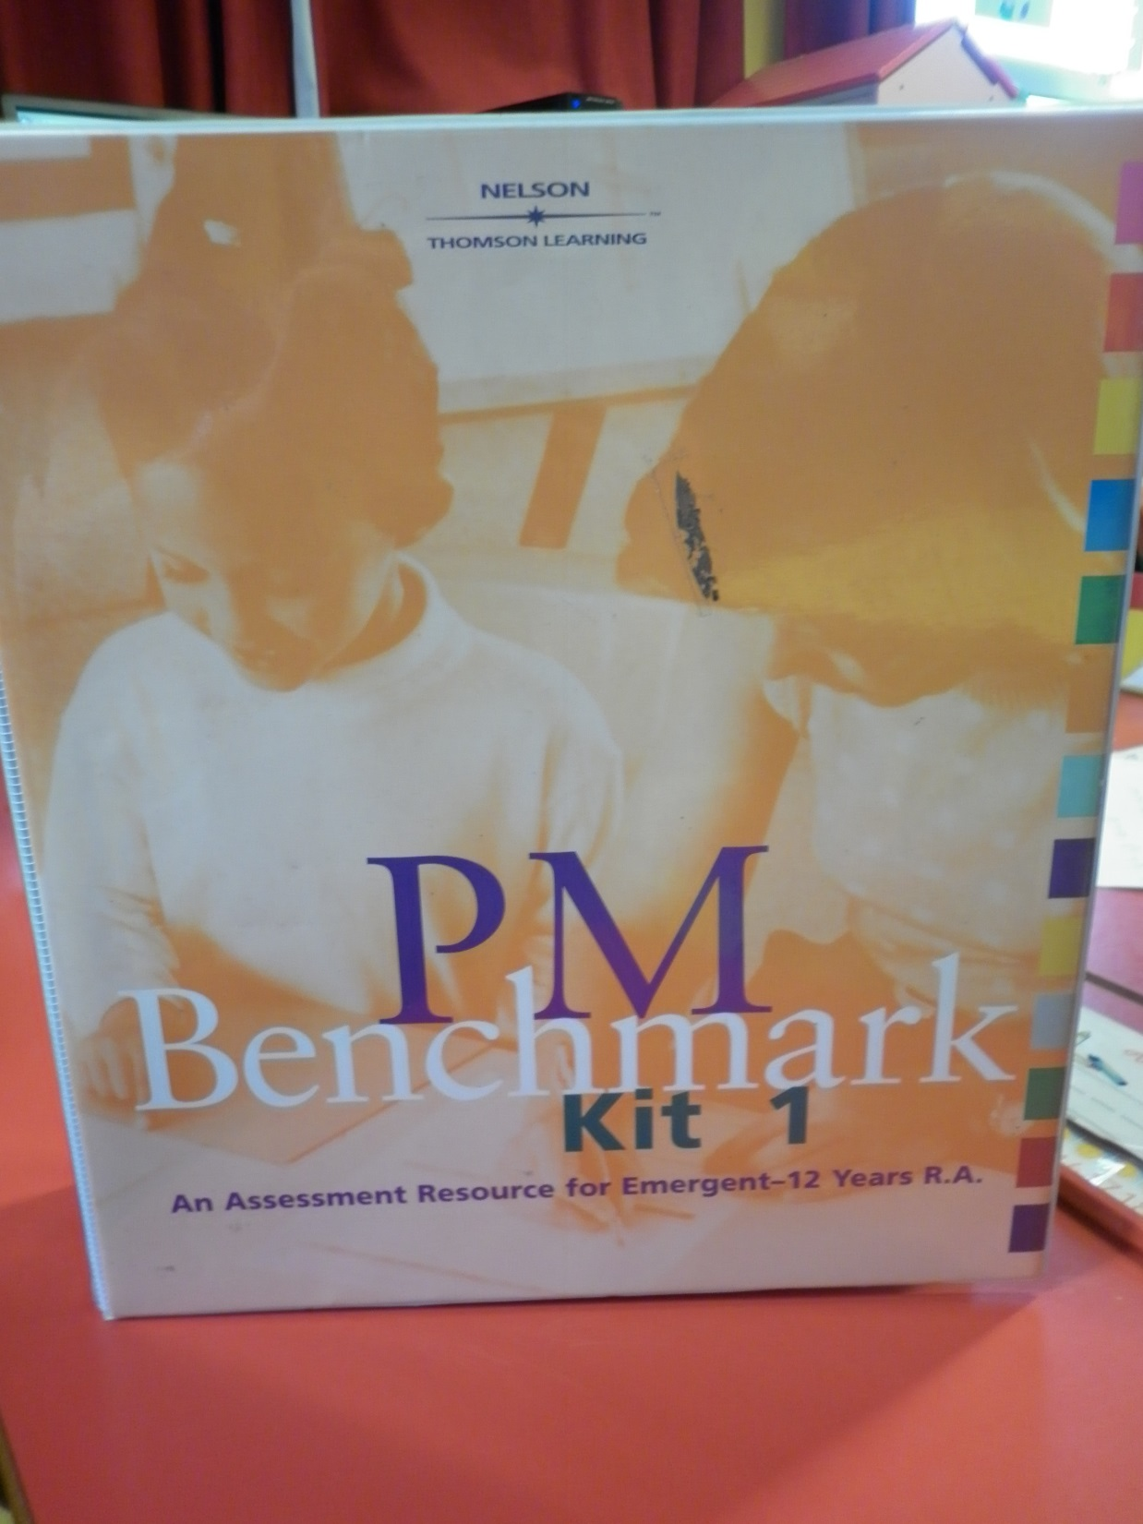

Slide 19
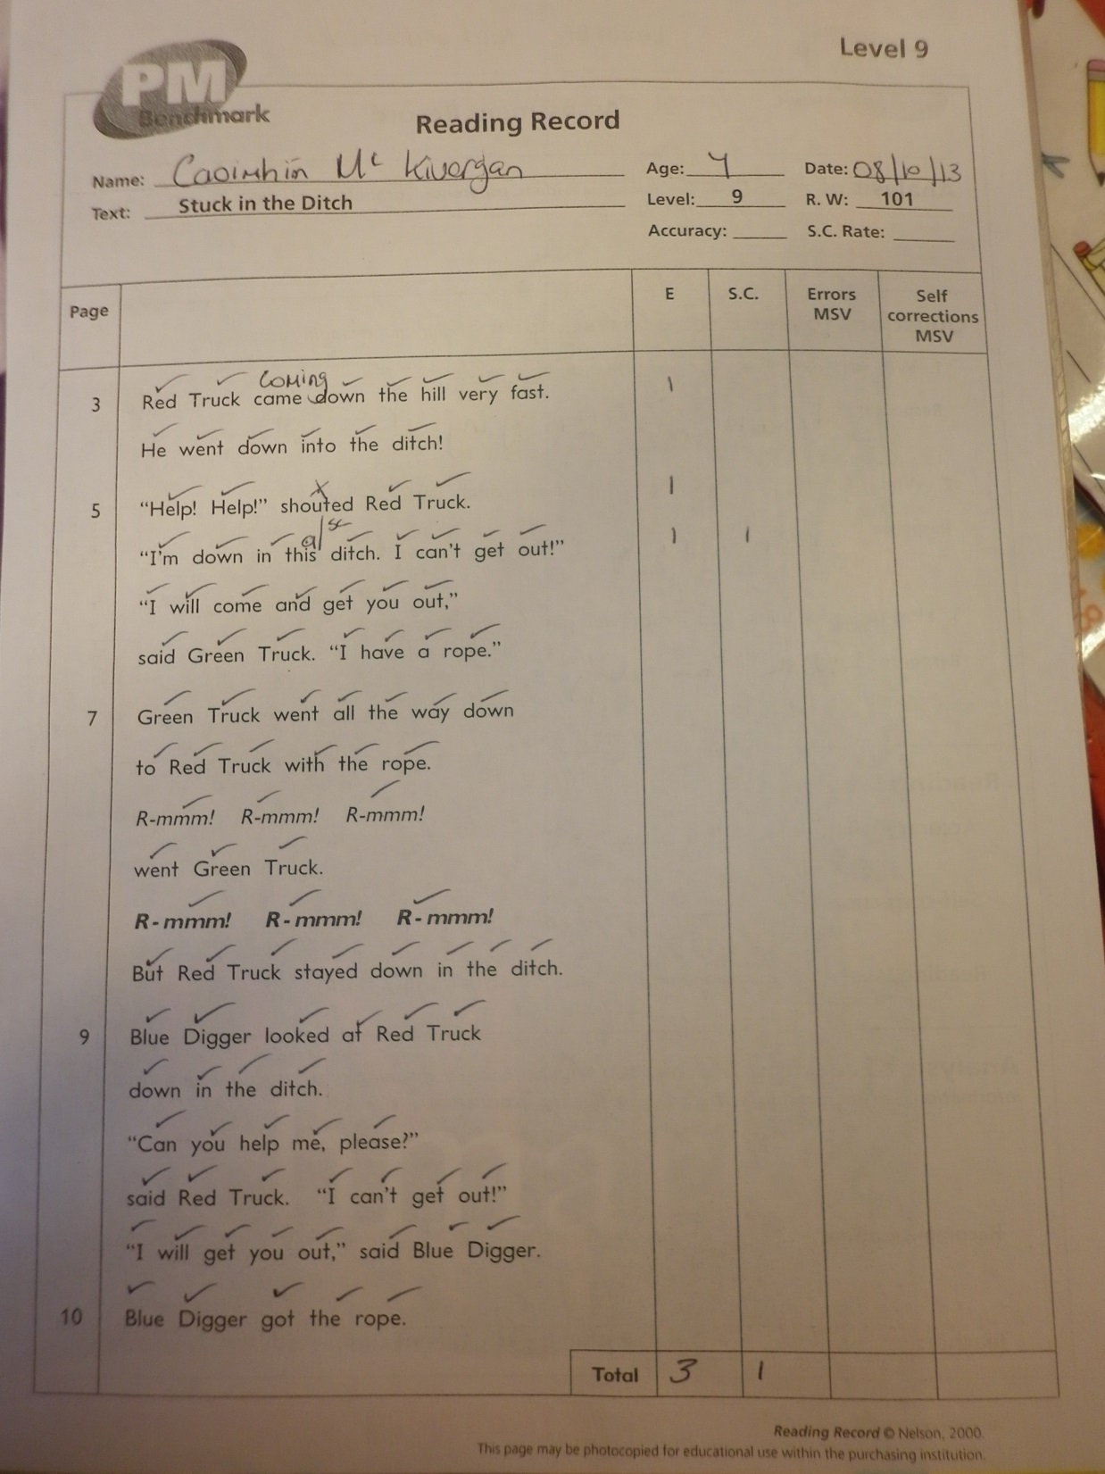

Slide 20
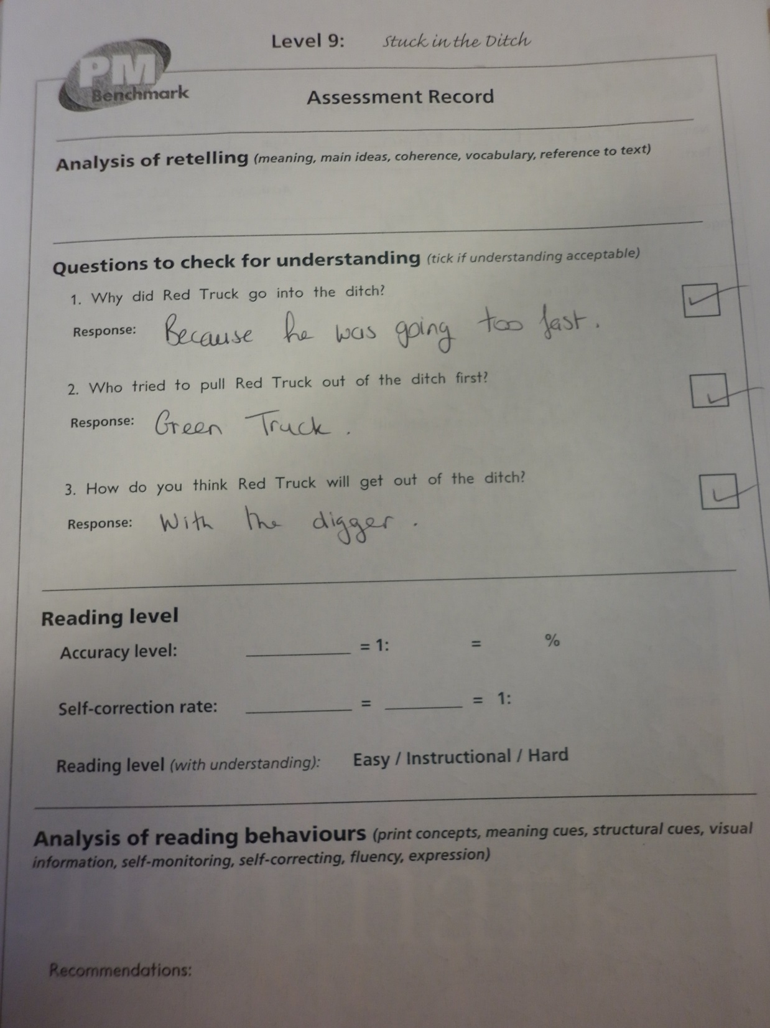

Slide 21
Leagan amach an cheachta:
gach Luan agus Céadaoin
Intreoir: 10bm (Linguistic phonics /léith i gcomhphairt/IWB)
Grúpaí: 4x10bm (léith. faoi threoir, tasc LP, LÁL, cairde cainte, ‘response to writing’).
*Téann o.baile abhaile gach Luan agus Céadaoin- tasc a bhaineann le LP agus liosta focal le cleachtadh don deachtú ar an Aoine.

Slide 22




Guided reading | LP task | Response to reading book | ‘Talking partners’
‘Talking partners’ | Guided reading | LP task | Response to reading book
Response to reading book | ‘Talking partners’ | Guided reading | LP task
LP task | Response to reading book | ‘Talking partners’ | Guided reading

Slide 23
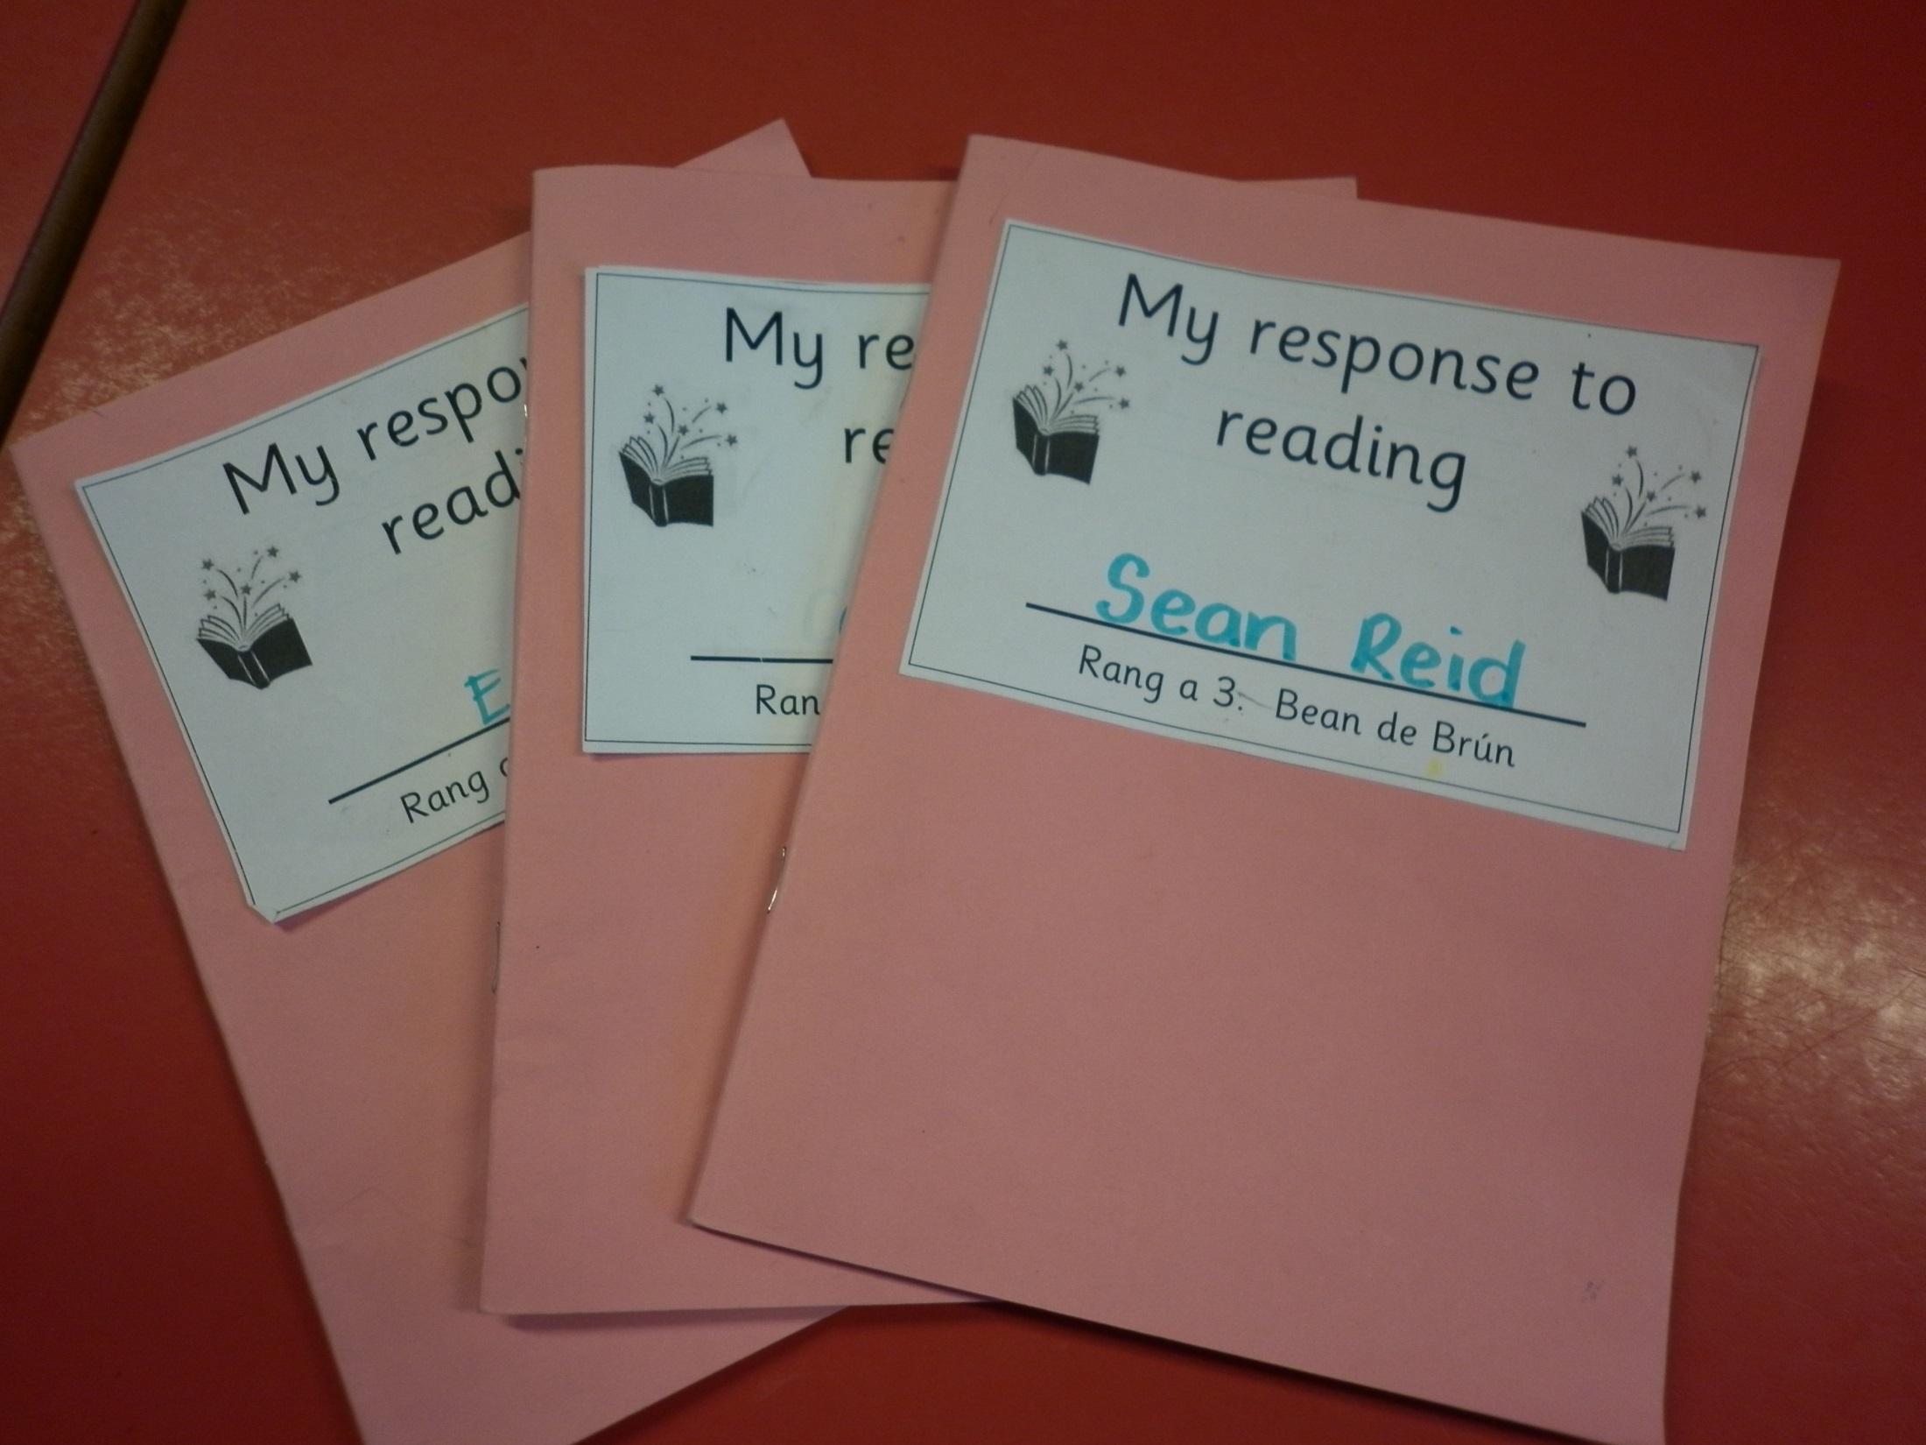

Slide 24
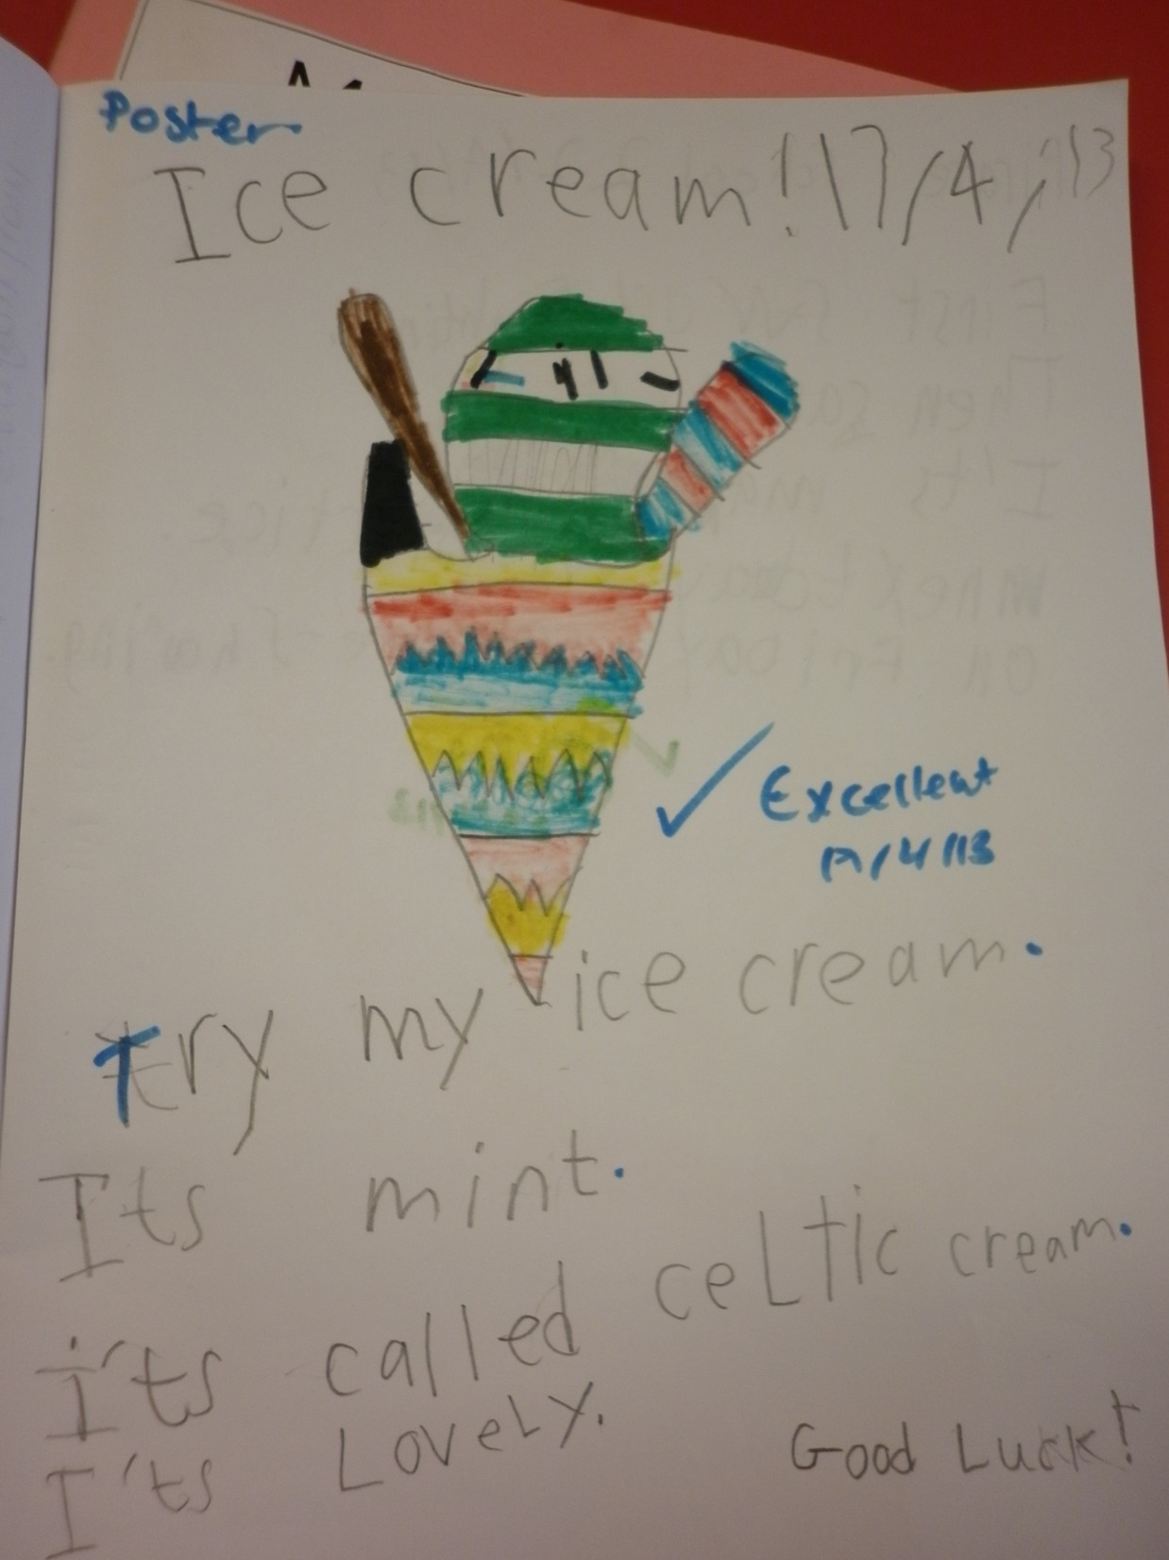

Slide 25
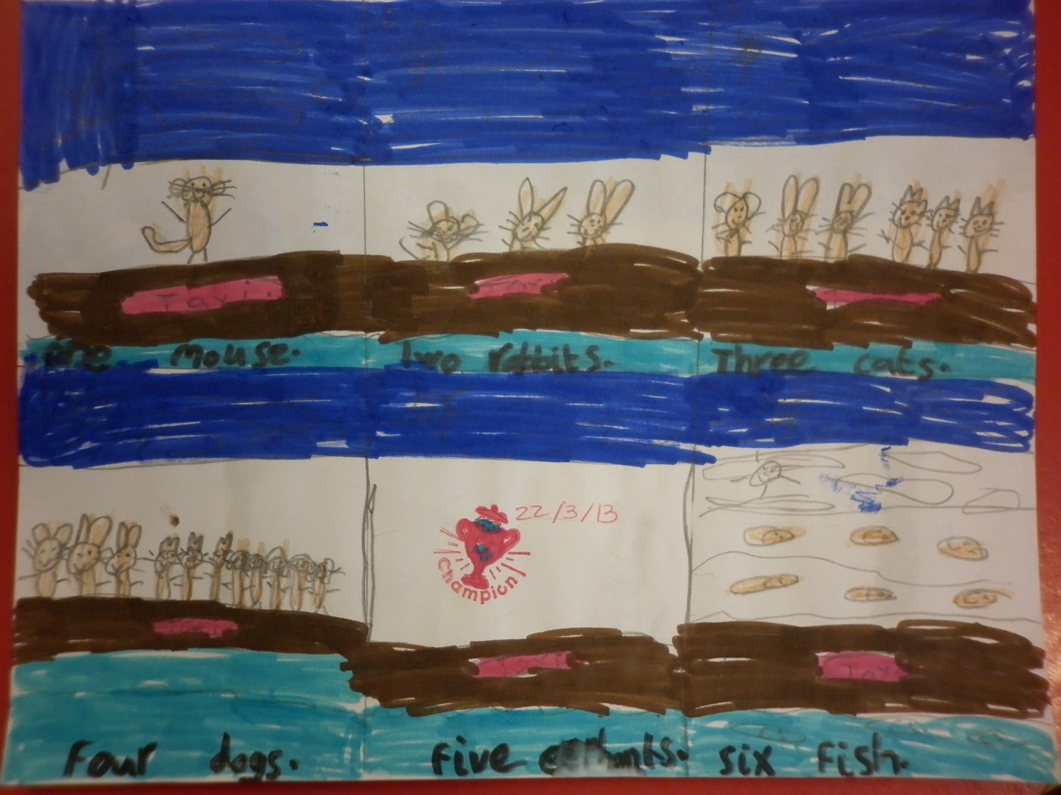

Slide 26
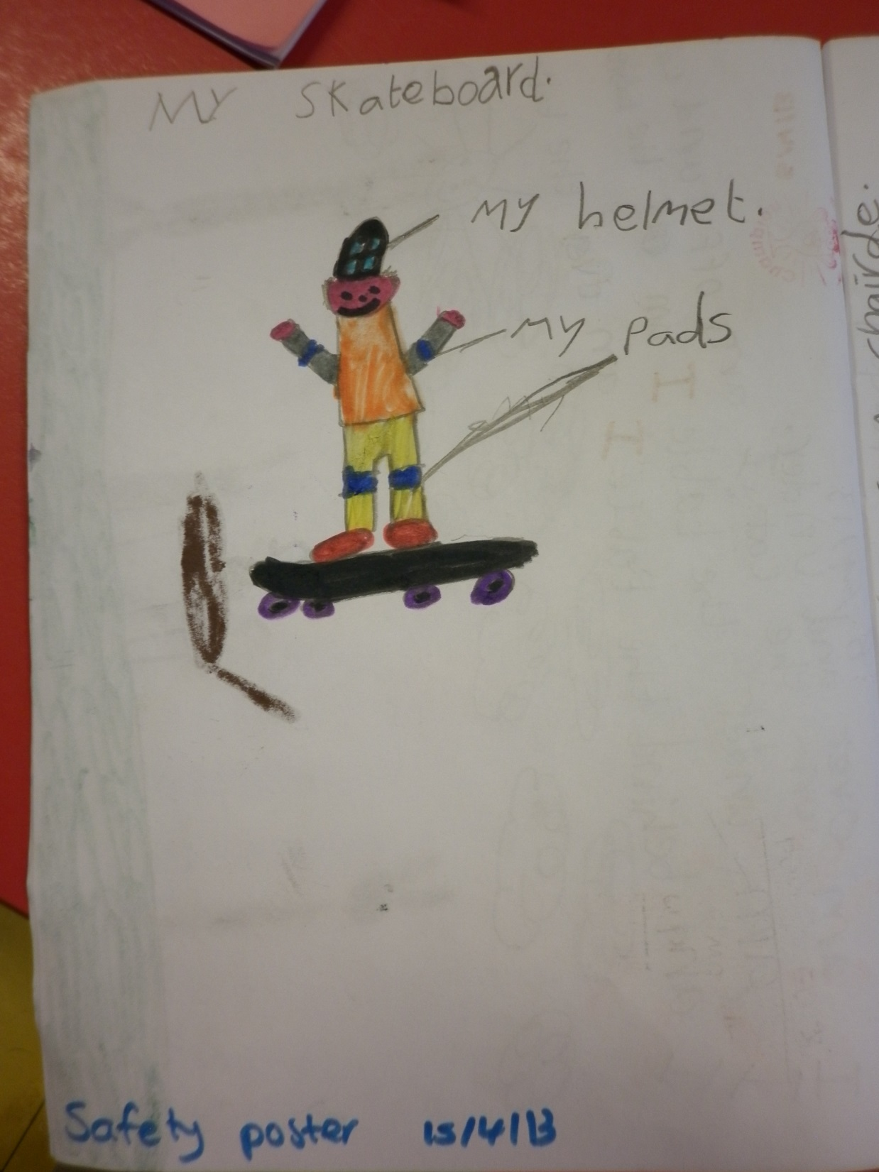

Slide 27
Pleanáil:
FAD-TÉARMA:
English reading overview (SELB literacy framework file)
Linguistic phonics yearly planner (BELB, Linguistic Phonics Manual)

Slide 28
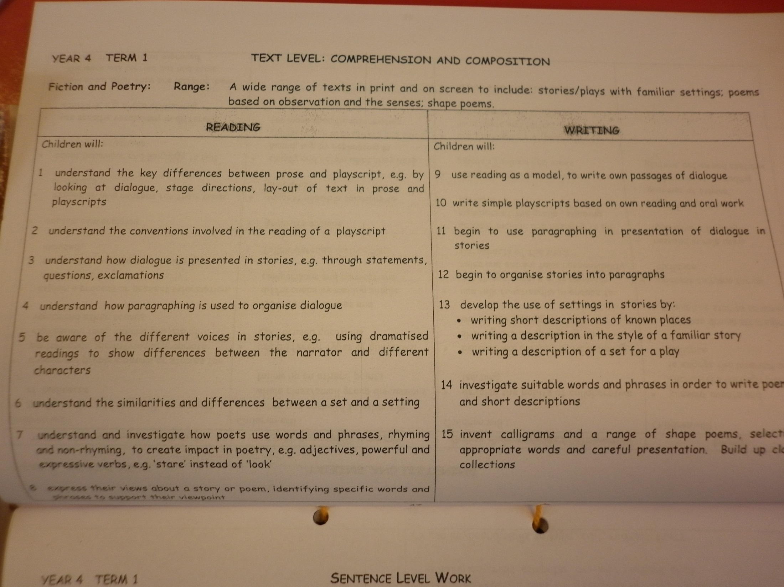

Slide 29
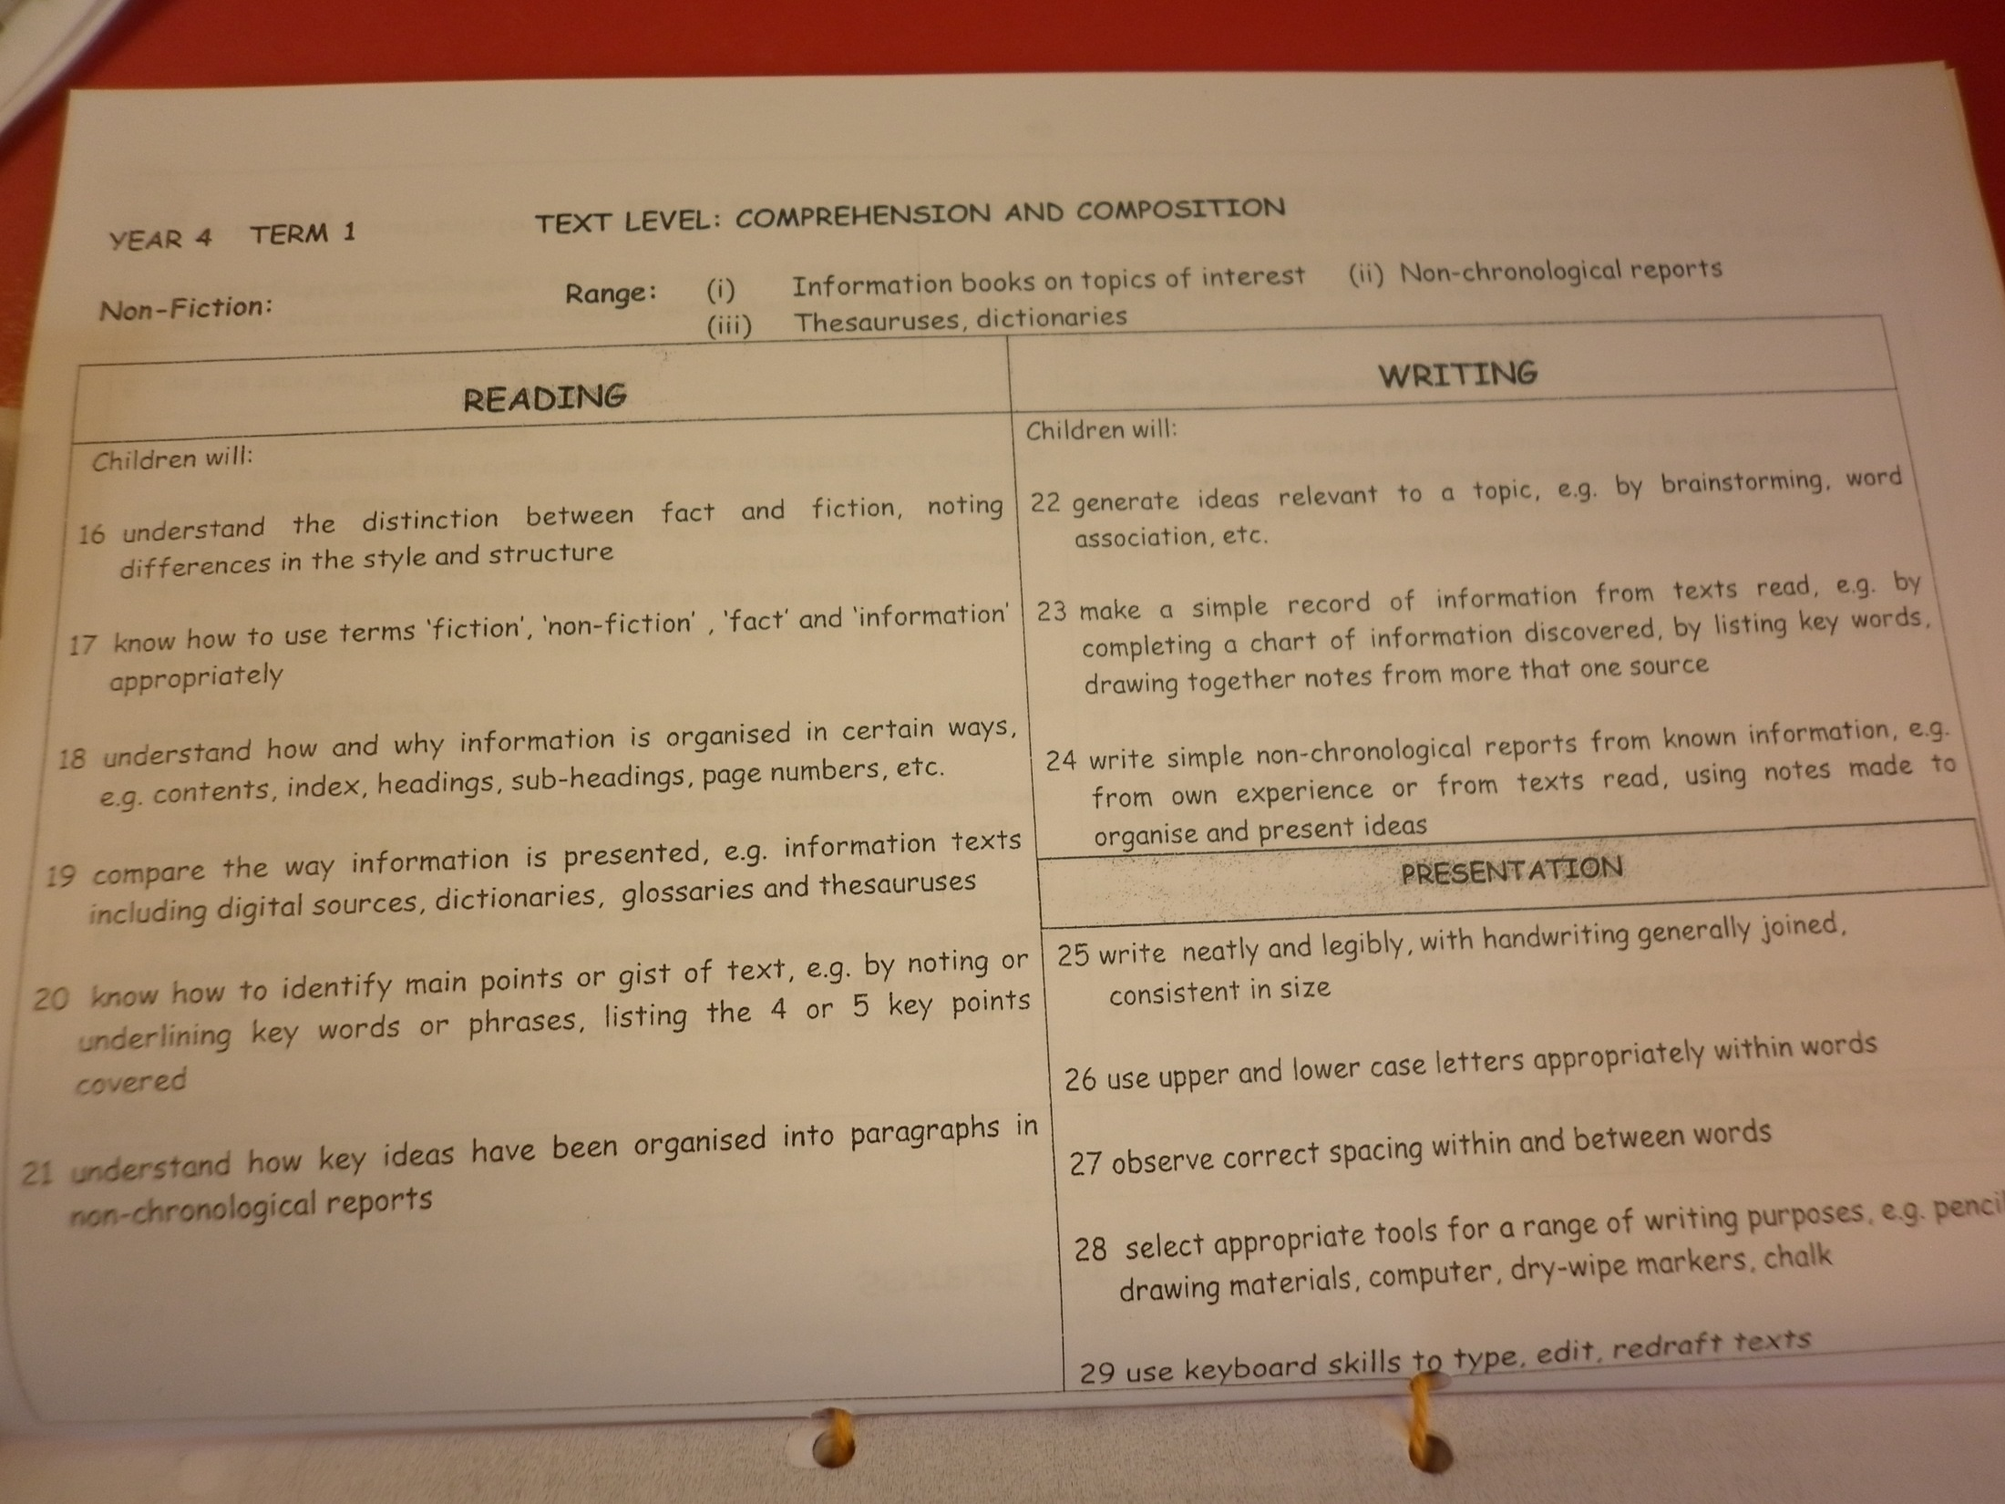
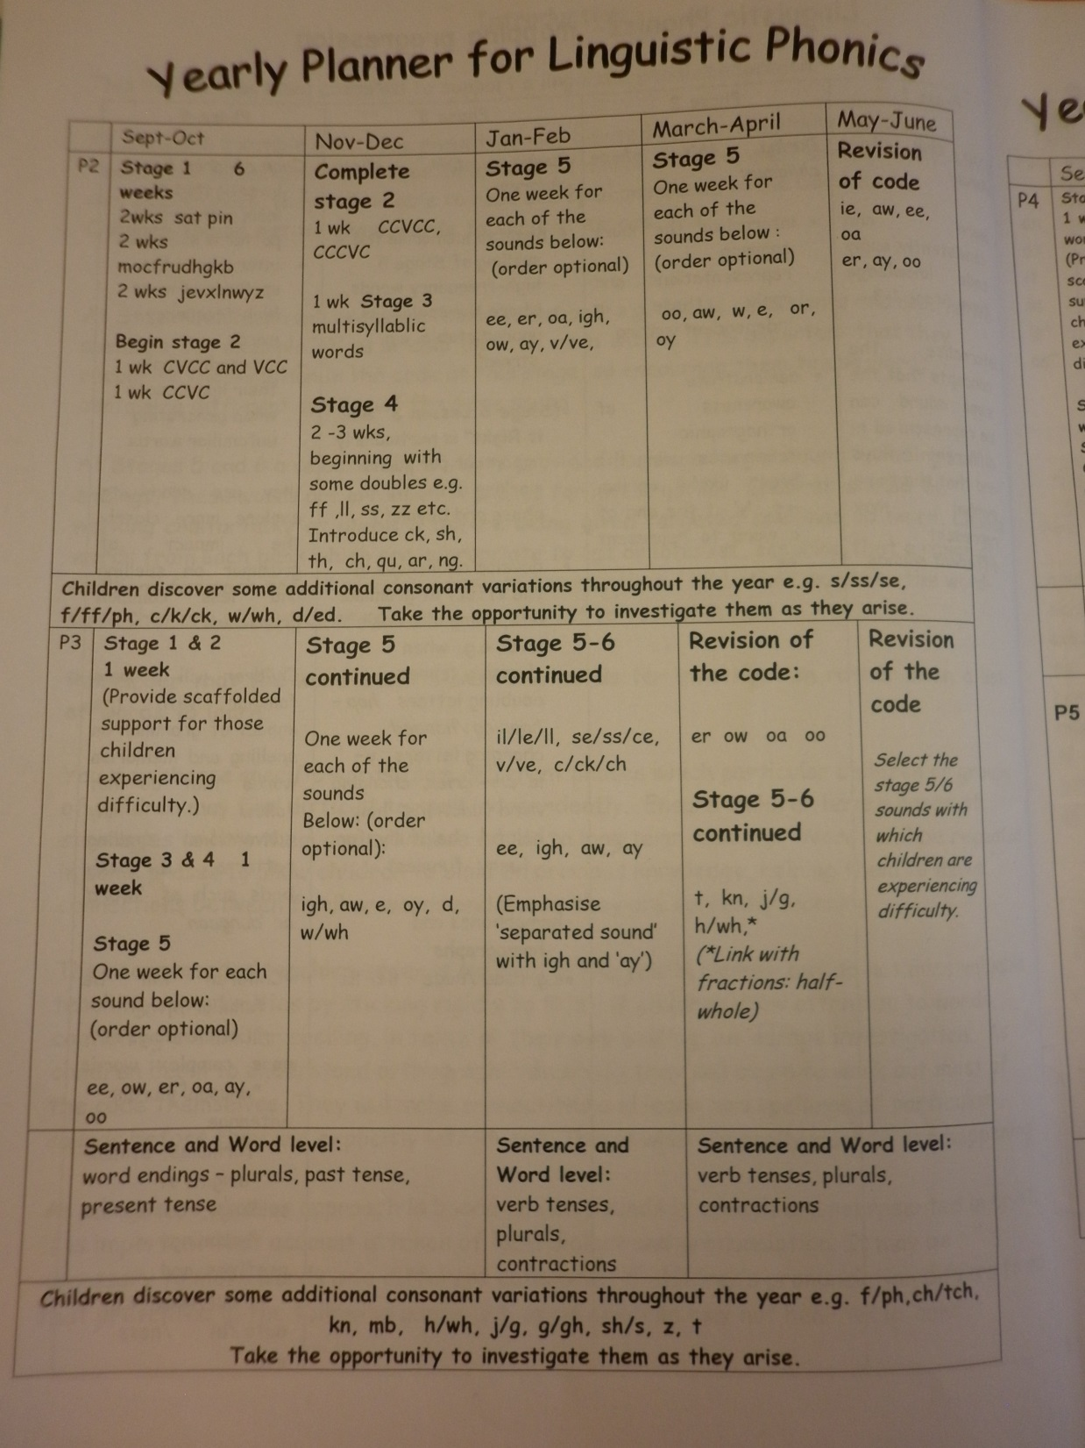

Slide 30
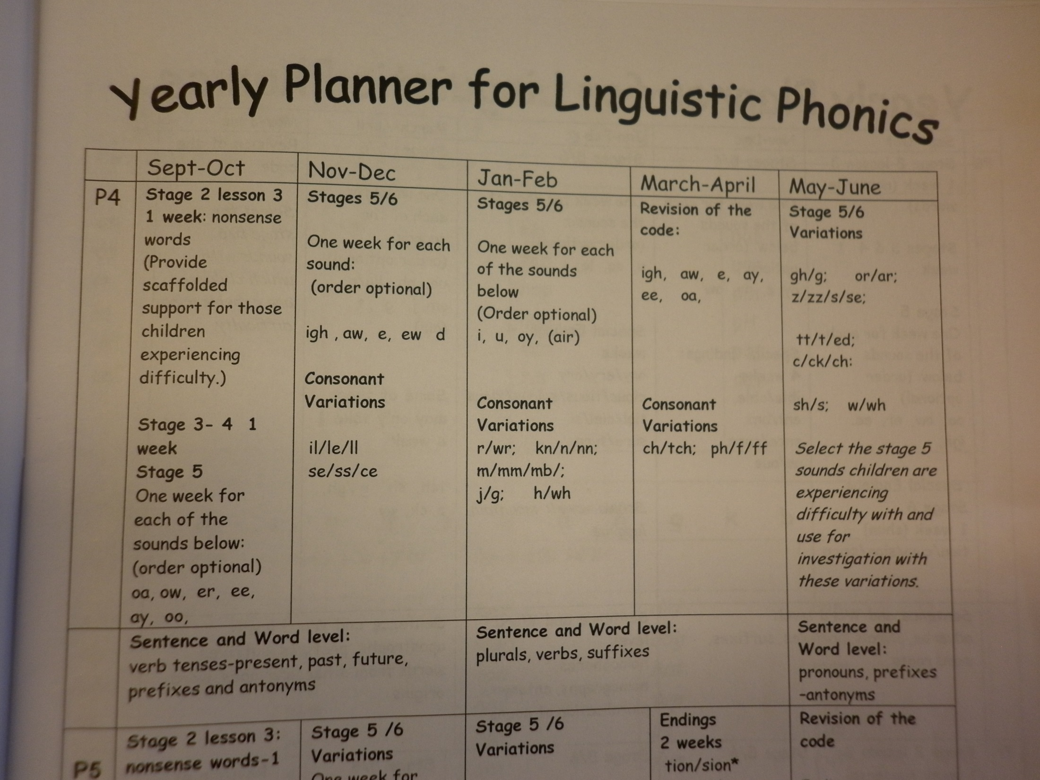
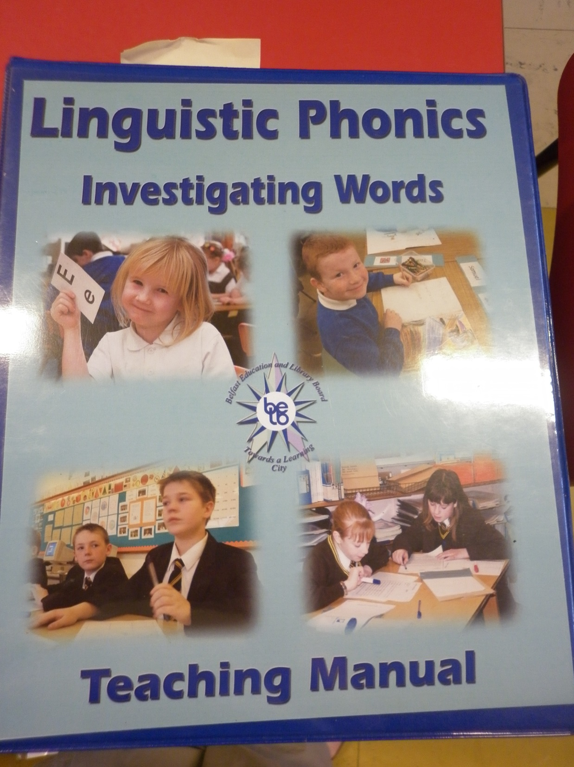

Slide 31
Pleanáil:
MEÁN-TÉARMA:
Year group medium term planners (written with year group)

Slide 32
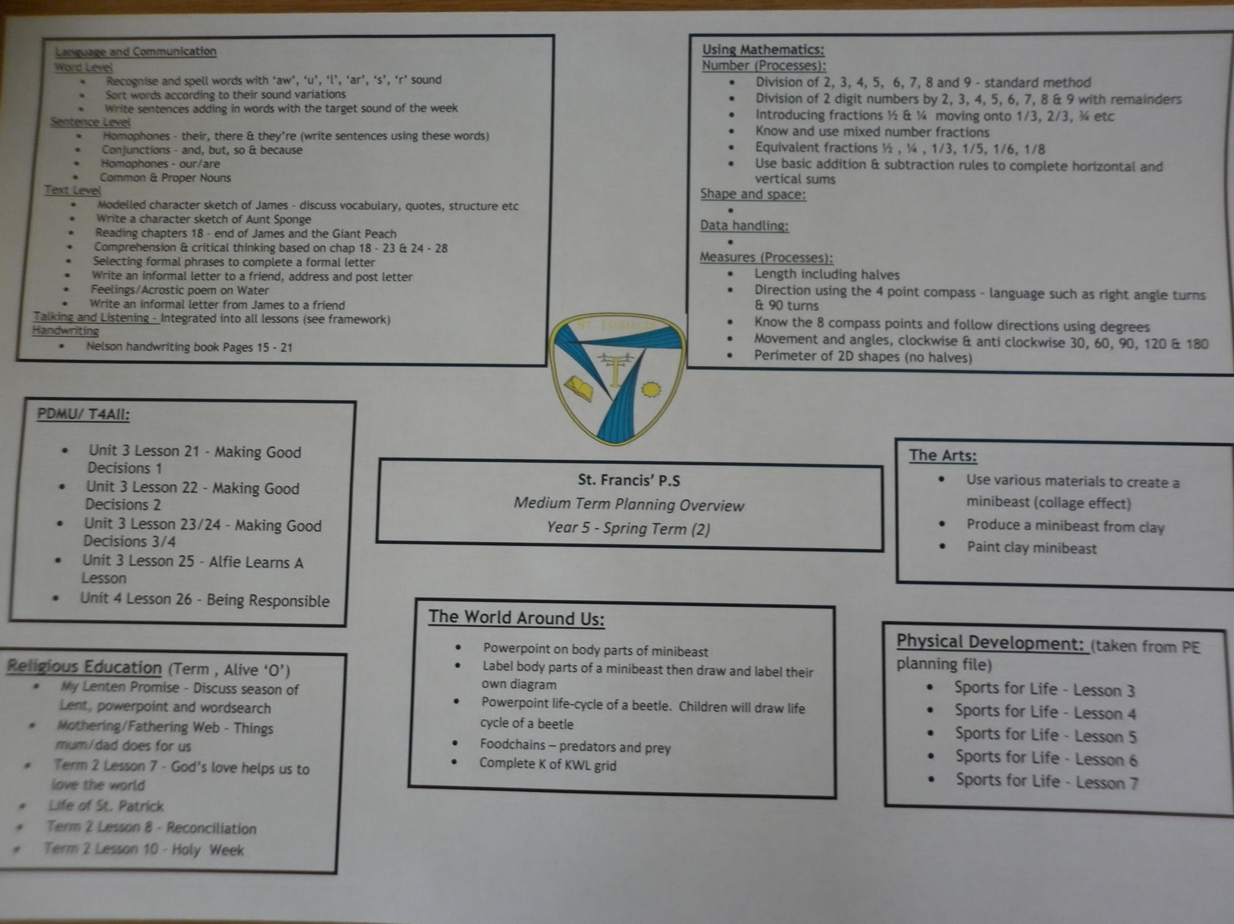

Slide 33
Pleanáil:
GEARR-THÉARMA:
Pleanóirí seachtainiúla
Nótaí an lae

Slide 36
Léitheoireacht an Bhéarla- measúnú
- Suffolk reading scale, R3-7
PIE, Rang 3-7
PM benchmarking running records (record and comprehension) R3-5
CCEA reading assessment tasks R4-7
DENI statutory testing e.g. INCAS, NILA etc…

Slide 37
Tagairtí:
Cummins, J. (1981).The role of primary language development in promoting educational success for language minority students.
Cummins, J. (1998). Immersion education for the millennium: ‘What we have learned from 30 years of research on second language immersion?’
First Steps NLS Edition Literacy Developmental Continuum: How to Assess Children's Literacy (1999) Pearson Education Limited.
Williams, C. (2000). On recognition, resolution and revitalization. In C. Williams
(Ed.), Language revitalization: Policy and planning in Wales (pp. 1–47). Cardiff: University of Wales Press.

